Slide 1


CMPE 255 DATA MINING
Multi-Agent Debate for
Math Generation
A Short Story on Karbasi et al. (UCLA, 2025)
Presented by Vineeth Chandra Sai Kandukuri

Slide 2




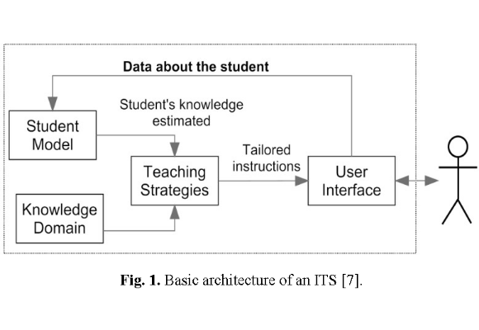
The Context: Intelligent Tutoring
The Goal
•
Personalized Learning: Systems must adapt to each student's pace.
•
Knowledge Tracing: Continuously tracking "Knowledge Components" (KCs) to find gaps.
•
The Need: Automatic Question Generation (AQG) to provide infinite practice material.

Slide 3


The "Goldilocks" Dilemma
Standard Large Language Models struggle with precise control.
•
Zero-Shot Failure: Asking for a "Medium" difficulty question often results in "Too Hard" or "Too Easy" outputs.
•
Hallucination: In education, a "hallucinated" difficulty level can ruin a student's learning trajectory.
•
The Gap: A single model pass isn't enough for pedagogical precision.

Slide 4
The Solution
Multi-Agent Collaborative Framework
Inference Time Computation (ITC)

Slide 5






Architecture 1: Teacher-Critic Cycle
Teacher
Critic
The Loop
Generates the initial question and answer draft based on the target difficulty.
Reviews for clarity, relevance, and difficulty. Does NOT rewrite, only critiques.
Iterative refinement process (2-5 rounds) until the output meets quality standards.

Slide 6



Architecture 2: Collective Consensus
Versatile Agents
Diversity
Consensus CEO
Multiple agents propose, revise, or endorse questions independently.
Randomized parameters (temperature, seed) ensure diverse perspectives.
A final decision-maker agent that reviews the transcript and selects the best option.

Slide 7
Evaluation Metrics
Relevance: Is the question strictly on-topic for the Knowledge Component?
Importance: Does it test a core concept or a trivial edge case?
Clarity: Is the linguistic phrasing precise and unambiguous?
Difficulty Matching: Does "Medium" actually mean "Medium"?
Answerability: Can the problem be solved with the given info?

Slide 8
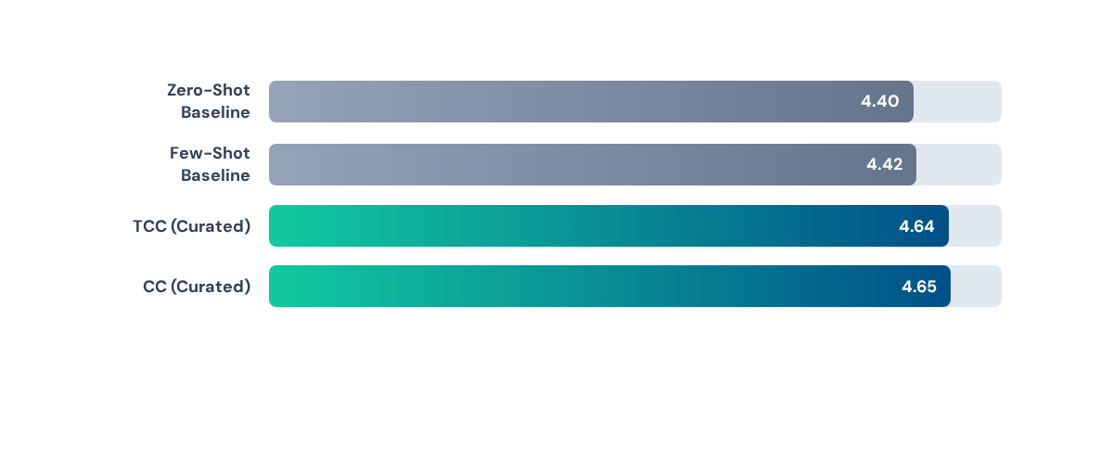
Results: Collaboration Wins
Multi-agent workflows (TCC & CC) consistently outperformed single-agent baselines, with the biggest gains in Difficulty Matching and Relevance.

Slide 9
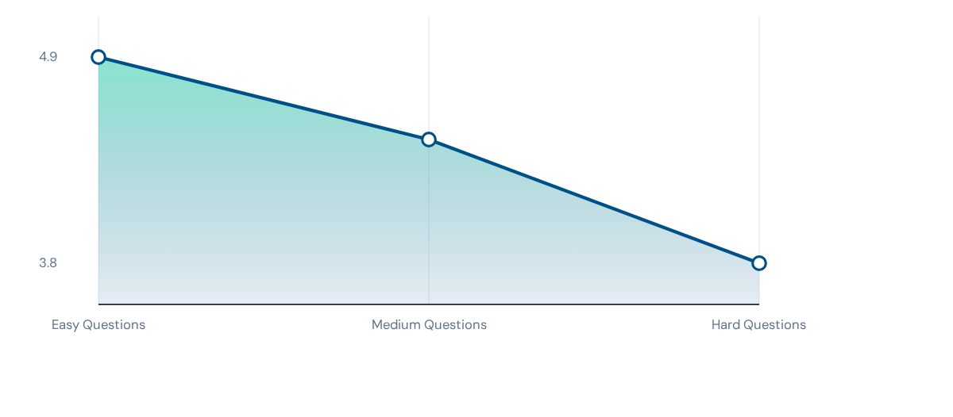
The "Hard" Problem
Performance drops significantly as difficulty increases. Generating "Hard" questions remains the biggest challenge for all models.

Slide 10


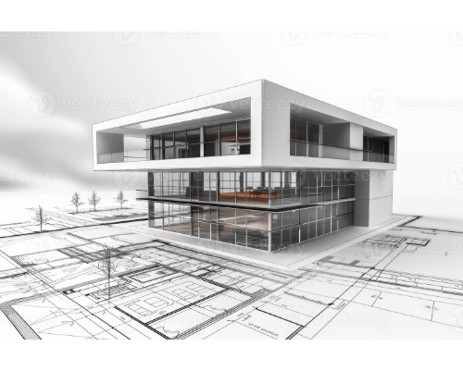
Prompting vs. Architecture
Few-Shot Prompting
Showing the model examples of similar problems ("Few-Shot") had little to no impact on performance compared to simple prompting. Context alone isn't enough.
Architecture Wins
The structure of the workflow (agents debating) matters more than the specific wording of the prompt.

Slide 11


My Two Cents
Limitations
Strengths
•
Incremental Gains: Improvements are steady but not revolutionary.
•
Flow Engineering: Proves workflows > prompts.
•
Consensus CEO: Smart design pattern for conflict resolution.
•
Cost: Running 5 agents per homework problem is expensive.
•
Safety: "Critic" loop prevents bad educational content.
•
Ceiling Effect: LLM graders might be too lenient.

Slide 12


Don't Zero-Shot It.
Build a Team.
The future of AI in education lies in collaborative agentic workflows.

Slide 13





Image Sources
https://figures.semanticscholar.org/403c0f91fba1399e9b7a15c5fbea60ce5f28eabb/2-Figure1-1.png
Source: semanticscholar.org
https://media.istockphoto.com/id/1327436571/vector/vector-illustration-of-afro-american-school-girl-in-uniform-confused-student.jpg?s=612x612&w=0&k=20&c=SFNxALDuyLTjnqMBNHjxrxqUrZMJs1grKd0gsMnMp08=
Source: www.istockphoto.com
https://static.vecteezy.com/system/resources/previews/047/327/378/non_2x/modern-architecture-concept-with-3d-house-rendering-over-blueprints-photo.jpg
Source: www.vecteezy.com
https://images.stockcake.com/public/4/5/1/451f00fe-ad9d-46c8-b8bf-e21b7badbd6a_large/students-building-robot-stockcake.jpg
Source: stockcake.com

